Slide 1

GRADE 4
UNIT 3
MY THINGS!
LESSON 4

Slide 2


Slide 3


Listen and point

Slide 4
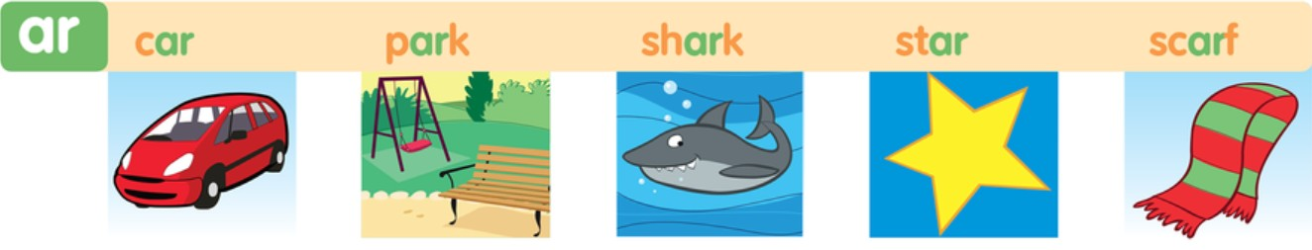


Slide 5
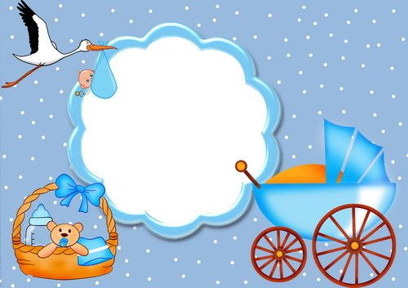


car

Slide 6
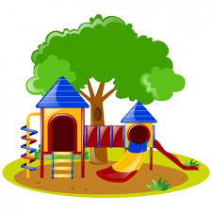
park

Slide 7

shark

Slide 8

star

Slide 9
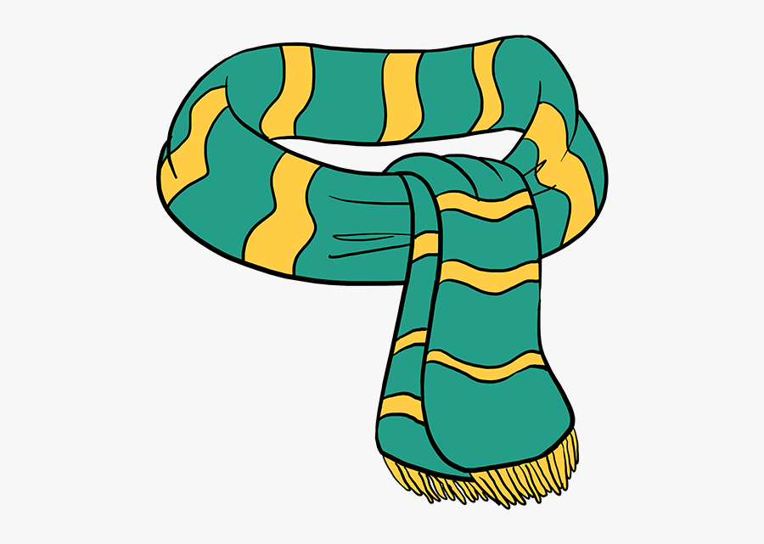
scarf

Slide 10

Let’s play a game.

Slide 11
UNSCRAMBLE.

Slide 12

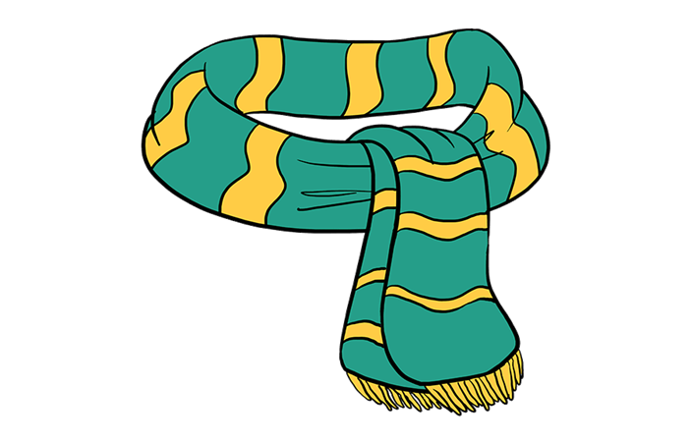
s r f c a
scarf
NEXT

Slide 13

r t a s
star
NEXT

Slide 14

h r s a k
shark
NEXT

Slide 15
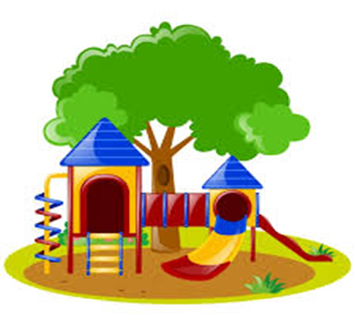
r k p a
park
NEXT

Slide 16

r c a
car
NEXT

Slide 17
Listen and point

Slide 18

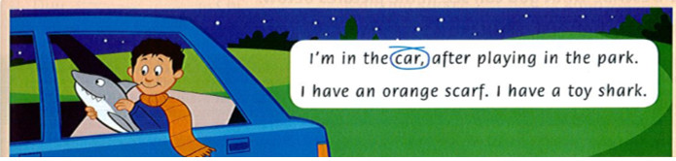

Slide 19
Read the chant again.
Circle the words with 'ar'.

Slide 20
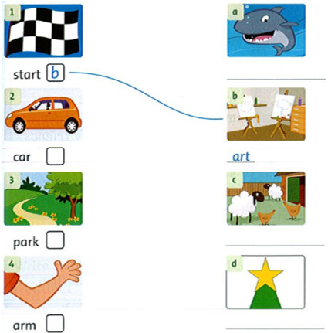
Match the words that rhyme
Write: farm / star / art / shark
shark
farm
star

Slide 21
Lesson 5
Listen and point

Slide 22


Slide 23

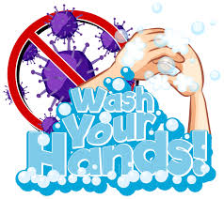
posters

Slide 24
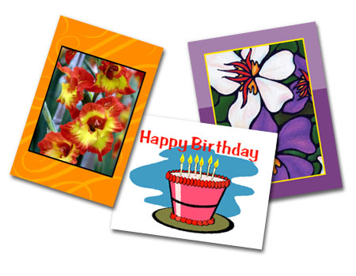
postcards

Slide 25
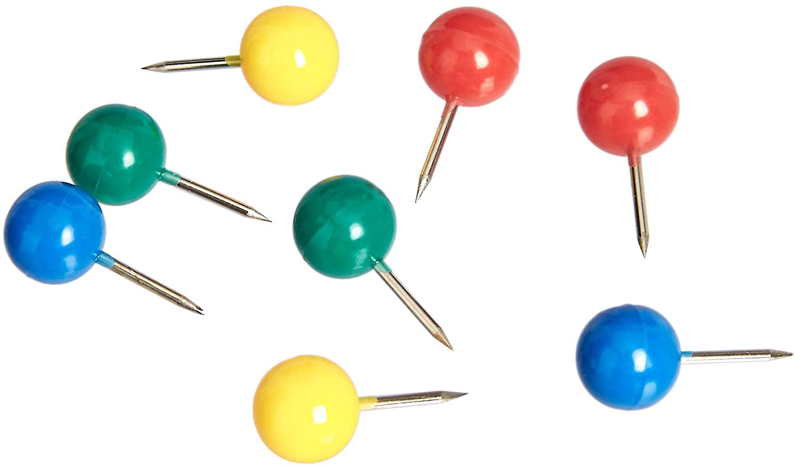
pins

Slide 26
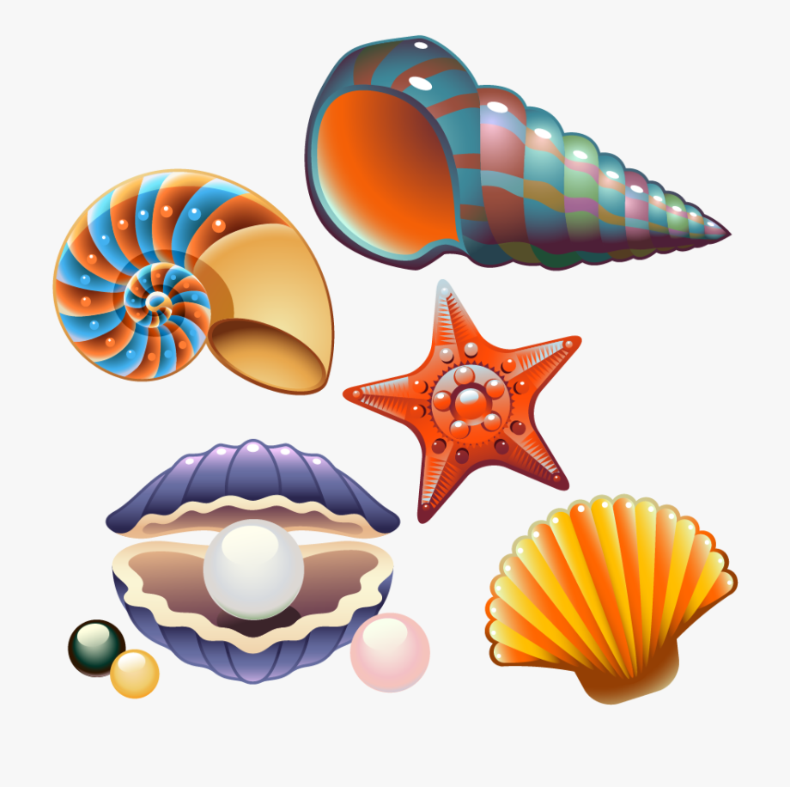
shells

Slide 27
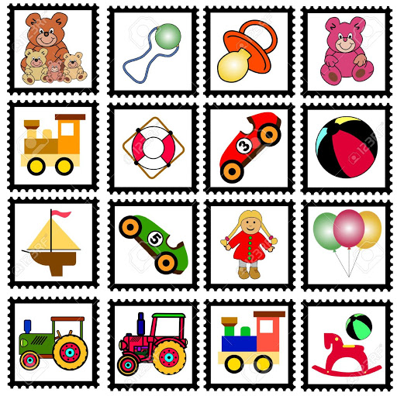
collection

Slide 28
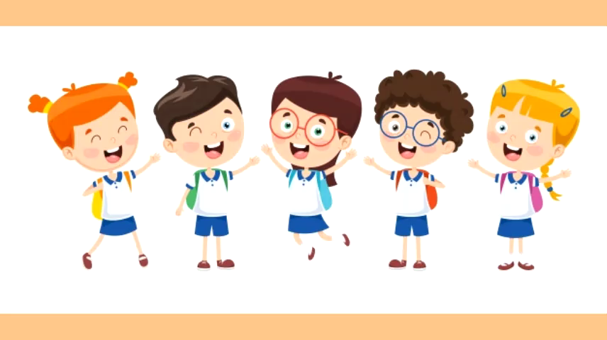

Slide 29
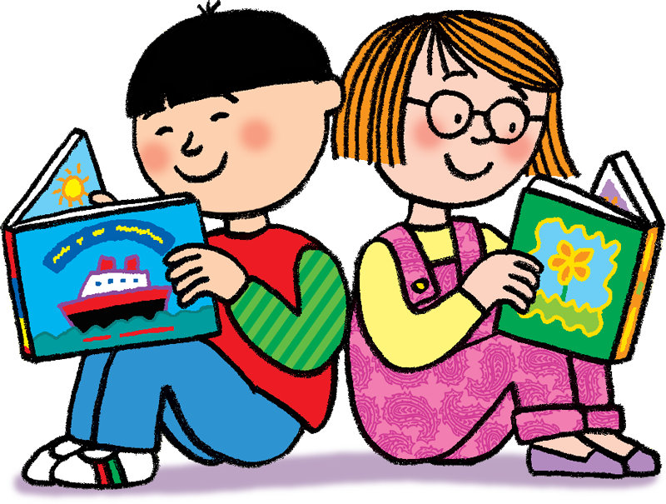
Open your book
and
Read again

Slide 30
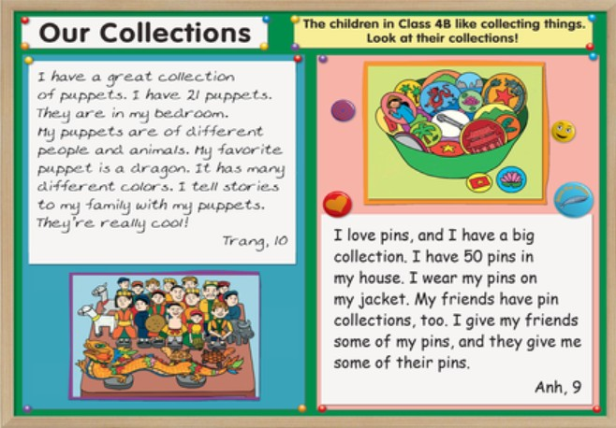

Slide 31
Let’s play a game.

Slide 32

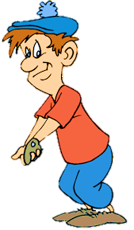
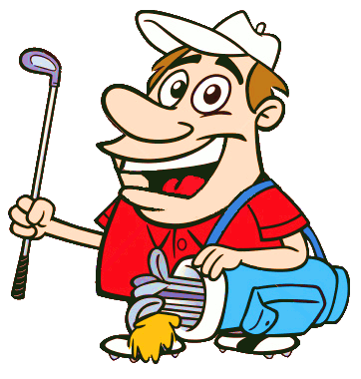



Anh or Trang

Slide 33
Anh
________ has 50 pins.
Trang
Anh
NEXT

Slide 34
Trang
_________ has a great collection of puppets.
Trang
Anh
NEXT

Slide 35
Trang
________’s favorite puppet is a dragon.
Trang
Anh
NEXT

Slide 36
Anh
________ has a pin collection.
Trang
Anh
NEXT

Slide 37
Trang
__________ tells stories to her family with her puppets.
Trang
Anh
NEXT

Slide 38
Anh
__________ wears pins on her jacket.
Trang
Anh
NEXT

Slide 39
Trang
_________ has 21 puppets.
Trang
Anh
NEXT

Slide 40
Anh
________ gives her friends some of her pins.
Trang
Anh
NEXT

Slide 41
Lesson 6: Listen

Slide 42
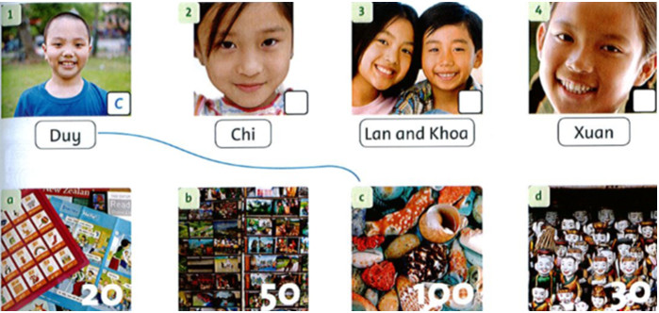
Listening
Listen and match.
What do they collect?

Slide 43
Tasks: Speaking
Look at the pictures.
Ask and answer.
Examples:
1. Does Duy have a collection?
=> Yes, he does. He has a shell collection.
2. How many shells does he have?
=> He has one hundred shells.

Slide 44
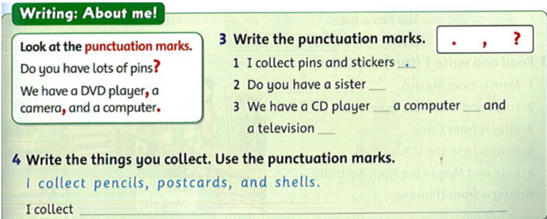
Writing
?
,
,
.

Slide 45


